Slide 1

Introduction to Physics Approximating Neural Networks (PANN) for Virtual Analog Emulation of Nonlinear Components
Christopher Johann Clarke and Jer-Ming Chen

Slide 2
Preamble slide
We know it could sound different, (Anecdotally .. Swapping out one component)
We know text book capacitor… physical complications
Predict behaviour
I present…
This is already published: here and here
there gonna be 2 part

Slide 3
Table of Contents
Motivation and Extent of Nonlinearity
Example of Nonlinearity
Physics Approximating Neural Networks (PANN)
Problem Setup and Nonlinear Capacitor Model
Results
Side comment on Distributional Shift (environment change)

Slide 4
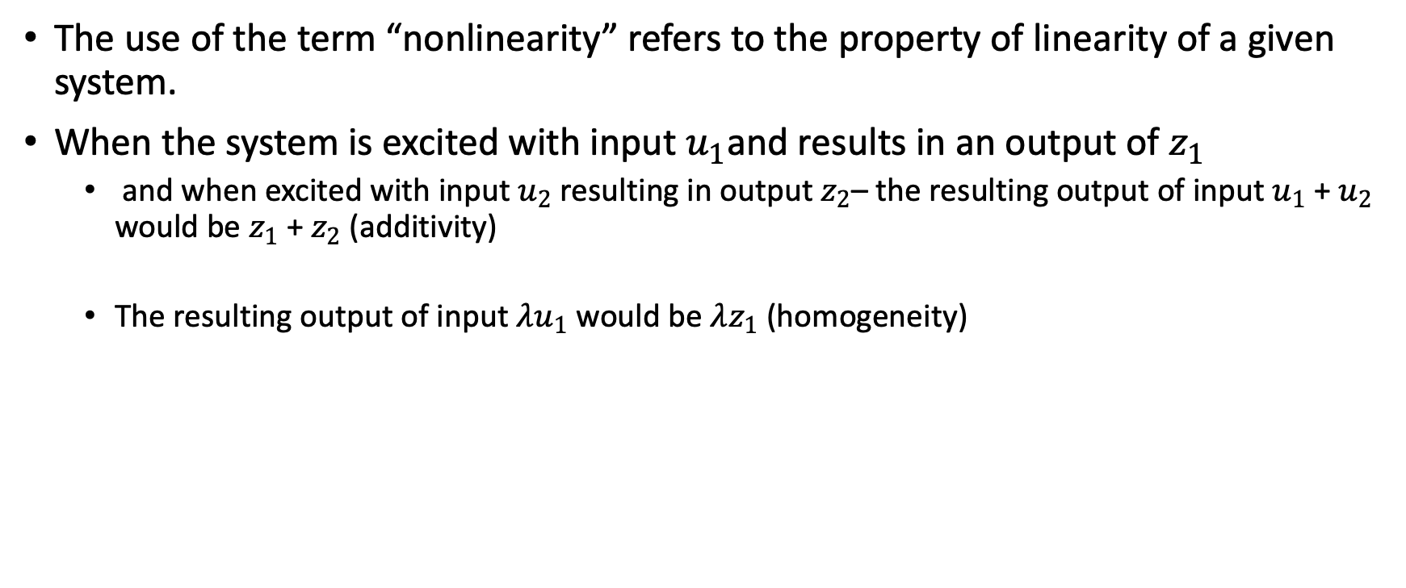
Preface
The use of the term “nonlinearity” refers to the property of linearity of a given system.
When the system is excited with input $u_{1}$and results in an output of $z_{1}$
and when excited with input $u_{2}$resulting in output $z_{2}$– the resulting output of input $u_{1}$+ $u_{2}$ would be $z_{1}$ + $z_{2}$ (additivity)
The resulting output of input $λu_{1}$ would be $λz_{1}$ (homogeneity)

Slide 5
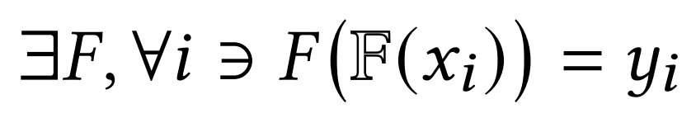
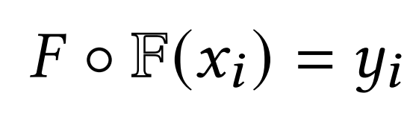
Motivation
Problems that present themselves in this form:
Not all input variables can be collected – Hidden Variables
Not all interactions between variables can be predicted – Hidden States
OR

Slide 6
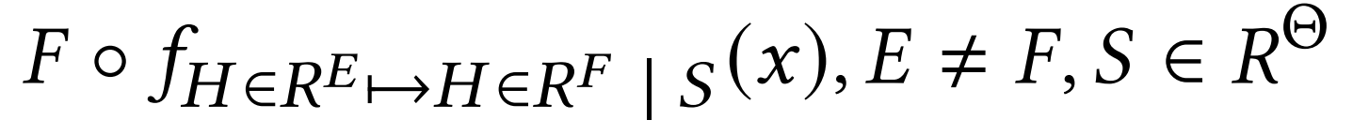

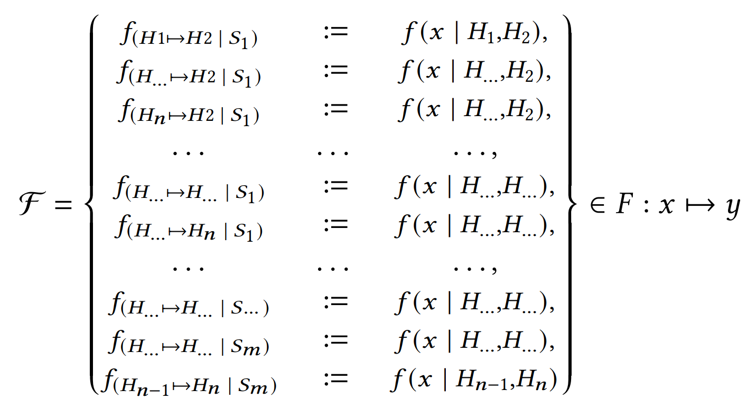
Motivation
Since each H and S will cause the function F to alter slightly, the function F can be represented as carrying/containing a family of functions F

Slide 7
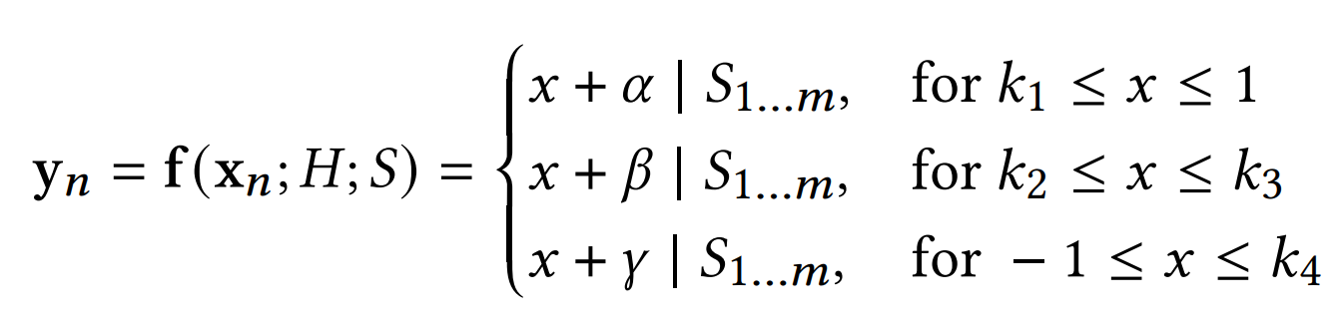
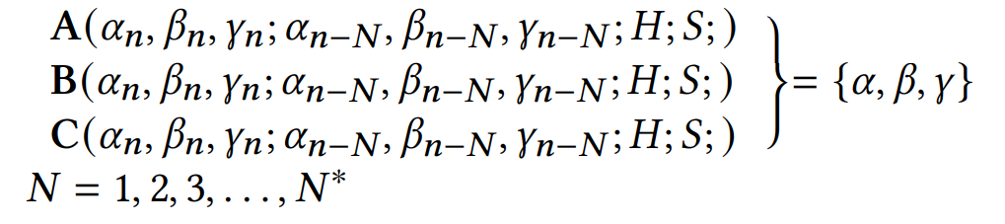
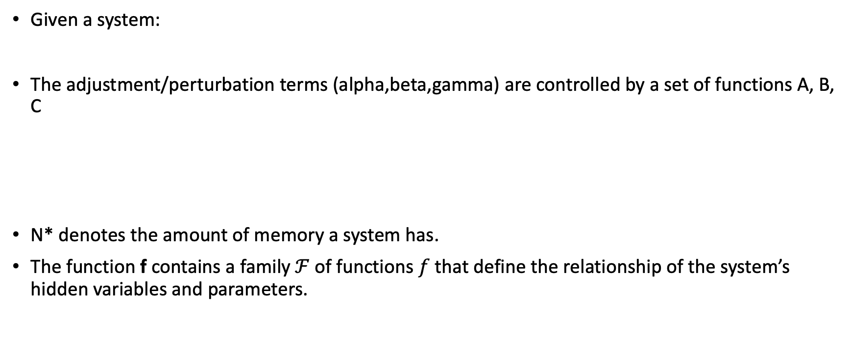
Example of Nonlinearity
Given a system:
The adjustment/perturbation terms (alpha,beta,gamma) are controlled by a set of functions A, B, C
N* denotes the amount of memory a system has.
The function f contains a family $ℱ$of functions $f$ that define the relationship of the system’s hidden variables and parameters.

Slide 8
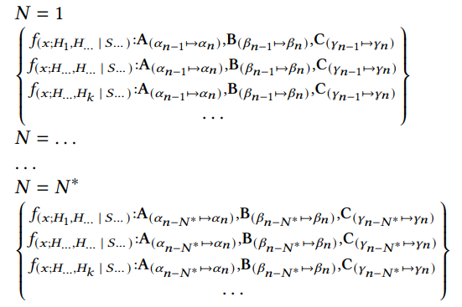

Example of Nonlinearity
For each N in the previous equation, the family $ℱ$of functions $f$ alters functions A, B, C at each time step of N:

Slide 9
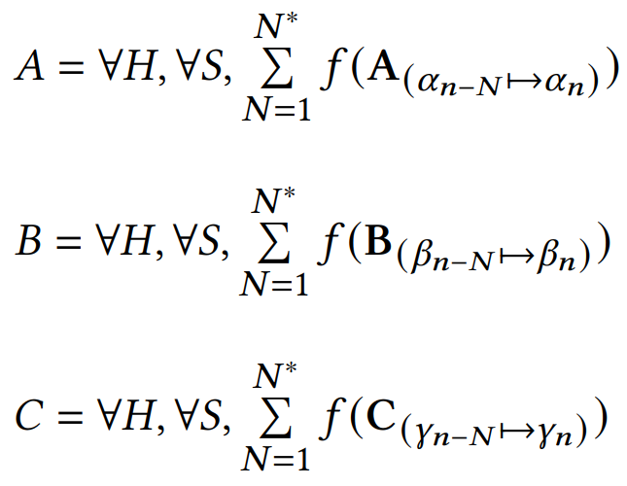

Example of Nonlinearity
The family $ℱ$of functions $f$ collapses to return functions A,B,C that produce the adjustment terms.
Graphically, this example can be thought of as a linear-piecewise function that changes slightly at each timestep.

Slide 10
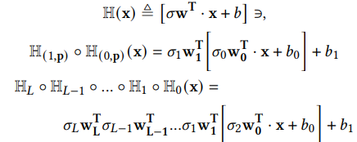

Physics Approximating Neural Networks (PANN)
Constructing a neural network that takes in a positive integer L, and a number of neurons per layer p :
Let H:
With shorthand operator:

Slide 11



Physics Approximating Neural Networks
We want to achieve the mapping M
The Error of the network N approaching 0 as the indicator of the mapping M approaching ground truth

Slide 12
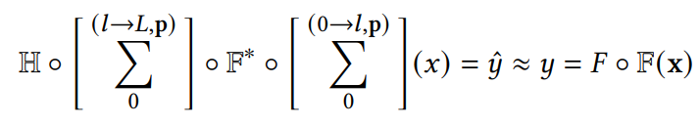



Physics Approximating Neural Networks
We can construct an “approximation layer” F*, and embed this layer within the network.
To give an example:
Variables are replaced with latent network inputs, unless the variable is the input to the model (x)
We can construct an “approximation layer” F*, and embed this layer within the network.
To give an example:

Slide 13
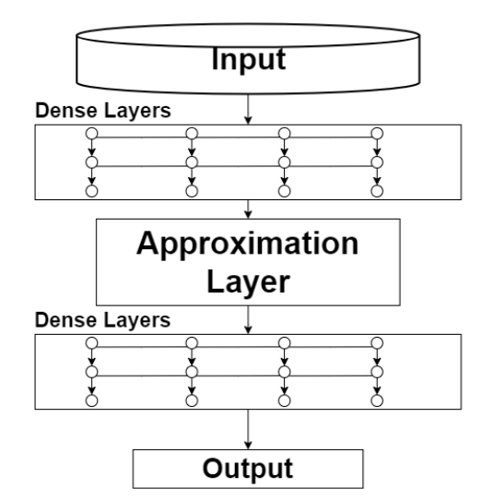
Physics Approximating Neural Networks
In this paper the preprocessing layer was a 2 x 8 (2 layers by 8 neurons) and a postprocessing layer was 5 x 8 (5 layers by 8 neurons)
preprocessing
postprocessing

Slide 14
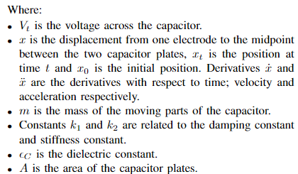

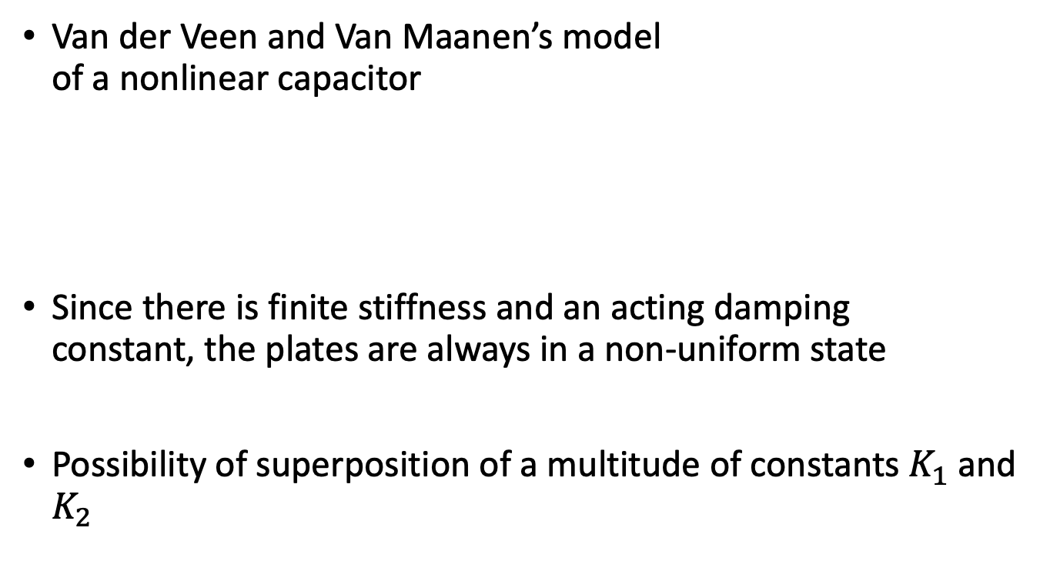
Problem Setup and Nonlinear Capacitor Model
Van der Veen and Van Maanen’s model of a nonlinear capacitor
Since there is finite stiffness and an acting damping constant, the plates are always in a non-uniform state
Possibility of superposition of a multitude of constants $K_{1}$ and $K_{2}$

Slide 15
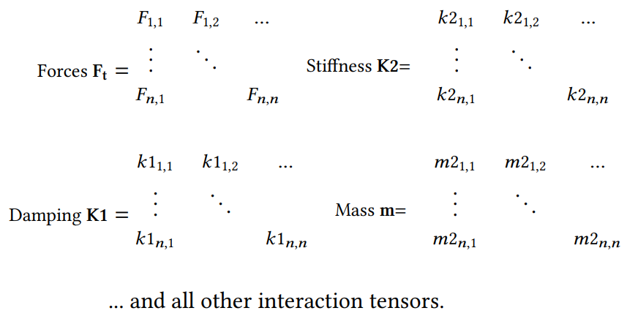



Problem Setup and Nonlinear Capacitor Model
Given at time t, an “interactions tensor” $I_{t}$:
The capacitor function C collapses $I_{t}$ to return the voltage across the capacitor
The family $ℱ$takes the function C($I_{t}$) as an input and returns the terms required.

Slide 16
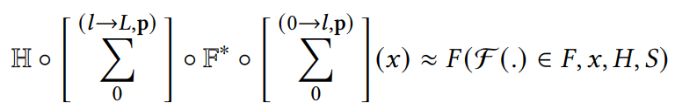

Problem Setup and Nonlinear Capacitor Model
The Physics Approximating Neural Network can then be constructed thusly:
Which has an F* of the form:

Slide 17
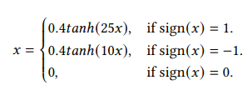

Results
The dataset used was from the Fraunhofer IDMT-SMT-Guitar Dataset.
The data was distorted as previous studies show that a distorted signal (associated,correlated,…) more capacitor nonlinearities. [citations]
A file containing about 2e7 samples was used to train the model with 80:20 split.
The waveshaper algorithm used was:
The output of the system was recorded at 44.1 kHz with a Universal Audio Apollo Twin Quad
The HPF frequency was around 9 Hz, far below the region of interest

Slide 18
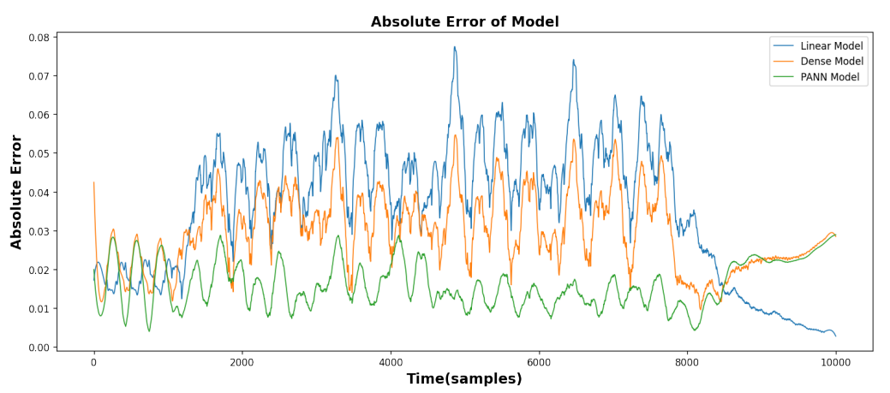
Results
The PANN model was trained alongside a Dense Model made of only densely-connected layers. This dense model was the same size as the PANN at 8 x 8. A linear model was also used to compare the results.

Slide 19
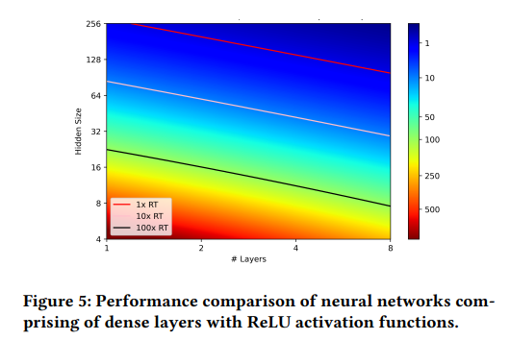
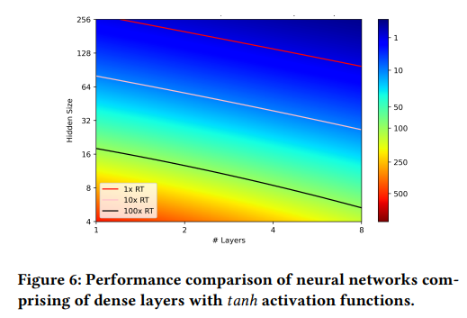
Conclusion
The transposability to a realtime deployment is possible with SIMD (possibly with RTneural)
The model could be improved through the use of Model Discovery using Genetic Algorithms or Network Architecture Optimizers.
The methodology displayed shows the possibilities of PANN, ultimately achieving more accuracy with the same computational resources.
Encourages the use of more informed/empirical models.

Slide 20
Thank You
Please contact me at christopher_clarke@mymail.sutd.edu.sg for any further questions.

